Slide 1
SAP on Azure: The Trusted Path to Enterprise-Ready Innovation in the Cloud
Leveraging SAP on Azure for Business Transformation – a Business Leader’s Perspective

Slide 2
Today’s agenda
1
2
Benefits of replatforming SAP to public cloud
Azure as the best public cloud
for SAP
Learning Objective
Learning Objective
How replatforming SAP applications to public cloud benefits the enterprise
Advantages of choosing Azure as a cloud platform and Microsoft as your partner for SAP applications
Notes:
This presentation will focus on two topics:
The benefits of replatforming SAP to public cloud
Why Azure is the best public cloud to run SAP applications

Slide 3
Benefits of replatforming SAP to public cloud

Slide 4
Digital transformation
Engage your customers
Transform your products
Empower your employees
Optimize your operations
According to Gartner, two-thirds of all business leaders believe that their companies must pick up the pace of digitalization to remain competitive.*
* Gartner, Smarter with Gartner, Embrace the Urgency of Digital Transformation, Oct. 30, 2017.
Notes:
Let’s start by talking about what is driving digital transformation and how you can embrace, adapt and innovate with the power of Azure’s hyperscale cloud platform.
With the ubiquitous presence of smart phones, rise of e-commerce and disruption in all industries enabled by the cloud and AI, business cycles are not only becoming faster, but competition and disruption is rising from different industries and players. Businesses that adapt to this faster cycle are much more data-driven in meeting customer demands for personalization, faster service and to grow in new markets or with newer business models.
In order to achieve digital transformation, we know that customers that run mission critical SAP ERP applications, are looking for newer ways to engage with customers, many are looking to accelerate innovation with newer products, optimize supply chain processes and finally empower employees to effectively use SAP data for decision making becomes paramount.

Slide 5
The challenge
Manual/slow processes
Slow innovation
Poor insight
Key business processes are batch processed, manual tasks that are expensive and slow down functions across the business
The business is slow to innovate given the time it takes to experiment, set-up and tear down IT infrastructure resulting in long time to value
Data lives in silos, moves slowly, and is not properly combined with non-SAP data to drive better decision making
Notes:
Now, what are some challenges with driving business transformation if you’re currently running on-premises or in hosted environments?
We hear that many business processes in legacy SAP ERP systems such as SAP Business Suite are still manual. For example, some of you might have staff dedicated to optimizing supply chain or reconciling financial data between ERP and other systems.
Current infrastructure on-premises or hosted is highly pre-planned with 3-5 year planning cycles and is not built for today’s fast paced innovation cycles to launch and learn new applications or business processes in days.
Finally, data sources are now varied and no longer just in your ERP. Data can be unstructured data from social, web or newer applications such as IOT in addition to applications that might be on non SAP stack. IT organizations are being asked to deliver insights across the entire organization which means IT needs to bridge these silos. We often hear customers tell us that to get to this type of insight requires hours of manual excel wrangling or working with complex custom solutions that require long project cycles and a significantly high cost to implement and maintain.

Slide 6
SAP in the cloud can power better business processes, innovation and insights
Faster, simpler processes
Accelerated innovation
360 insight
Azure offers a high performance infrastructure for SAP
Accelerate innovation by removing barriers and time to set up systems, enabling fast experimentation –accelerating the build, measure and learn cycle
Generate compelling insights by aggregating SAP and non-SAP data to provide a 360° view of markets, transactions and customers
Notes:
The solution is to adopt SAP’s new digital core ERP, S/4HANA, running on an agile cloud platform such as Azure to power your innovation and insights. S/4HANA allows organizations to run live, with analytics and transactions from the same system as opposed to running batch processes.
Azure offers a high-performance platform for running SAP applications
Customers running SAP on Azure can accelerate innovation for agile product cycles with an on-demand infrastructure that you can spin up/down in minutes and take advantage of the advances in AI and machine learning to automate business processes.
Finally, by running SAP on Azure, you will have the ability to provide a unified view of your data across the enterprise by combing SAP and non-SAP data in the cloud.
Now let’s see how the partnership between SAP and Microsoft uniquely enables this for you.

Slide 7
Advantages of public cloud over traditional on-premises architecture for SAP
Scalability
Workloads grow as quickly as demand requires without delay and can shrink or end-of-life without the worry of hardware lock-in.
Speed of provisioning
Since infrastructure is in place and operational, provisioning time is vastly reduced.
Partner and services ecosystem
Whole ecosystems of vendors offering technology and services are available.
Built-in tooling
Robust tools for implementing and managing workstreams reduce management overhead for IT teams.
Pay for use
Only pay for the capacity you actually use, delivering budget efficiency and flexibility to respond to changing competitive and market conditions.
Notes:
Public cloud carries inherent advantages over traditional on-premises architecture. Clarifying and communicating these advantages contributes to partners’ ability to win migration engagements.
Scalability
Public cloud allows extreme flexibility for scaling up or down usage as needed. Workloads can grow as quickly as demand requires without the delay required for adding new hardware, and similarly they can shrink or end-of-life without the worry of hardware lock-in.
Speed of provisioning
Since public cloud infrastructure is already in place and operational, provisioning time for new or updated applications is vastly reduced.
Partner and services ecosystem
The large number of companies using leading public cloud platforms has attracted whole ecosystems of vendors offering technology and services on these platforms.
Built-in tooling
Public cloud platforms bring with them robust tools for implementing and managing workstreams, tools designed to reduce management overhead for their customers’ IT teams.
Pay for use
Enterprises only pay for the computing capacity they actually use on a public cloud. Not only does this model deliver budgetary efficiency, but more importantly, it affords businesses flexibility to respond quickly to changing competitive and market conditions.

Slide 8

Opportunities for moving SAP to public cloud
↑
↑
↑
Hardware refresh required
End-of-support for critical hardware/software components
Digital Transformation or cloud-first initiative
Move to HANA or other SAP upgrade project
End of hosting or outsourcing contract
Business needs require better access to SAP data for analytics
M&A activity
Change in decision maker
Particularly the upcoming 2025 end of support for NetWeaver
Notes:
Many enterprises choose to time their move to the public cloud around other events requiring expense outlays or development projects. Aligning your move to public cloud around these other requirements can improve you efficiency of cost and effort for both projects.
Hardware refresh required
Move to HANA or another SAP upgrade project
Digital Transformation or cloud-first initiatives in the enterprise
End of support for critical hardware or software components
In particular end of support for ECC6 in 2025
End of relevant hosting or outsourcing contracts
LOB requirement for easier and more immediate access to SAP data for analytics
Change in decision maker internally
M&A activity

Slide 9
Microsoft Azure: The best cloud platform for SAP

Slide 10
Azure is the best platform for running SAP in the cloud
Hybrid cloud
The only public cloud that offers on-premises instances for true same-platform support in a hybrid cloud environment.
Data privacy
Microsoft spends more than $1 billion annually on cloud security. With more than 70 compliance certifications, Microsoft has the most certifications for SAP of any public cloud provider.
Reliability
Highest industry uptime Service Level Agreements, with 99.99% uptime SLAs for OLAP and OLTP. Includes integrated disaster recovery as part of all service packages and offers easy, economical storage options.
Analytics
Generate compelling insights by aggregating SAP and non-SAP data to provide a 360° view of markets, transactions and customers.
Capacity
With the largest SAP-certified instances on public cloud (up to 60 TB), Azure offers the most headroom of any cloud provider.
Global presence and support
High-speed connectivity in 50 regions and availability in 140 countries with more than 1500 peering points for express routing, more than any other public cloud provider. Microsoft has offices and personnel in every global market and understands the needs of local business.
Notes:
Azure is the premium public cloud offering for SAP, offering greater capabilities and robustness than other public cloud offerings and the most trustworthy platform for business-critical systems.
Hybrid cloud
Azure is the only public cloud that offers the ability to stand up an on-premises instance for true same-platform support in a hybrid cloud environment.
Reliability
Azure offers the highest uptime Service Level Agreements, with 99.99% uptime SLAs for OLAP and OLTP. Azure includes integrated disaster recovery as part of all service packages and offers easy, economical storage options.
Capacity
With the largest SAP-certified instances on public cloud (up to 60 TB), Azure offers the most headroom of any cloud provider.
Data privacy
Microsoft spends more than $1 billion annually on cloud security. With more than 70 compliance certifications, Microsoft has the most certifications for SAP of any public cloud provider.
Analytics
Generate compelling insights by aggregating SAP and non-SAP data to provide a 360° view of markets, transactions and customers.
Global presence and support
Azure offers high-speed connectivity in 50 regions and is available in 140 countries with more than 1500 peering points for express routing, more than any other public cloud provider. Microsoft has offices and personnel in every global market and understands the needs of local business in a way that other cloud providers cannot.

Slide 11
Reliable, high capacity SAP infrastructure on Azure
On-demand infrastructure
Purpose-built infrastructure
E-series VMs for dev/test and PoC
M-series VMs for most
implementations
SAP HANA Large Instances for extreme scale and performance
Up to 0.5 TB RAM
Globally available
192 GB to 4.0 TB RAM
SAP HANA certified for production
0.7 TB to 24 TB RAM
SAP HANA certified for production
Notes:
In Azure, we’re invested to give you highly scalable and performant infrastructure if you’re embarking on HANA.
Azure has virtual machines for dev/test, POCs as well as certified by SAP for production. They provide pay-as-you-go infrastructure with full certification for HANA and support upto ½ TB of RAM.
But we know SAP HANA systems can explode pretty quickly. So we’ve built specific hardware to give you unparalleled scale and performance. Called SAP HANA Large Instances they’re based on purpose-built infrastructure for HANA, are fully managed with 99.99% SLA and have up to 20 TB RAM per node for Scale-up OLTP workloads such as S/4HANA, Suite on HANA. Currently available for production in the US, EU and Australia. We are the only hyperscale public cloud provider that can offer up to 20 TB HANA certified instances. These instances can also support up to 60 TB for scale-out OLAP scenarios such as SAP Business Warehouse.

Slide 12
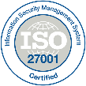
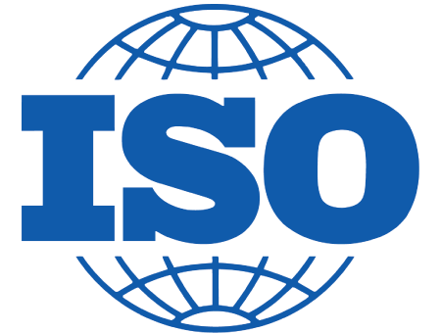
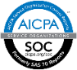



















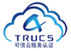













More compliance offerings than any other cloud provider
GLOBAL
ISO 27001
ISO 27018
ISO 27017
ISO 22301
SOC 1 Type 2
SOC 2 Type 2
SOC 3
CSA STAR
self-assessment
CSA STAR
certification
CSA STAR
attestation
INDUSTRY
PCI DSS
level 1
CDSA
MPAA
FACT UK
Shared
assessments
FISC Japan
HIPAA / HITECH Act
HITRUST
GxP
21 CFR Part 11
MARS-E
IG Toolkit UK
FERPA
GLBA
FFIEC
REGIONAL
Argentina PDPA
EU
model clauses
UK
G-Cloud
China
DJCP
China
GB 18030
China
TRUCS
Singapore
MTCS
Australia
IRAP/CCSL
New Zealand
GCIO
Japan my
number act
ENISA
IAF
Japan CS mark gold
Spain
ENS
Spain
DPA
India
MeitY
Canada
privacy laws
Privacy
shield
Germany IT
Grundschutz
workbook
Notes:
Compliance and trust is not an afterthought at Microsoft.
It is a leader in this space and helps set standards for global and federal organizations around the world.
Microsoft has been talking about trust in the cloud for a while and will continue to do so.
This is only a sampling of Azure’s compliance certifications, and they run the gamut.
Azure’s strengths are around security, privacy, and transparency around how Microsoft runs the cloud.
Azure has more than 70 certifications for SAP, more than any other cloud provider.

Slide 13
SAP HANA on Azure Region Availability
(*) DS v3 and ES v3 are available in all regions.
50-region network with high-speed connectivity
1,500+ peering points for express routing
UK West
UK South
Canada East
North Europe
Canada Central
M
M
G
M
M
L
G
G
Germany Central
West US2
G
M
M
L
M
M
L
East US
China North 2
M
Japan East
West US
L
G
East US2
G
L
M
Japan West
US Gov Arizona
M
M
G
West Europe
China East 2
L
M
M
G
US Gov Virginia
M
Central India
East Asia
M
M
M
South India
GS-series
M-series
M
G
Southeast Asia
G
M
L
HANA LARGE INSTANCES
M
Brazil South
G
M
L
Australia East
Generally available
Launching in CY18
Launching in CY19
M
Australia Central, Australia Central 2
M
L
Australia Southeast
Microsoft Roadmap Content, subject to change
Notes:
Azure offers the best global footprint of data centers and high-speed peering points. Azure can offer in-region or in-country data processing for more countries than any other public cloud provider.
Azure also offers hybrid cloud, allowing you to keep sensitive data local using on-premises hardware you control.
50-region network with high-speed connectivity
Available in 140 countries
1,500+ peering points for express routing

Slide 14
Microsoft and SAP: The best business partnership for ERP on public cloud

Slide 15
Microsoft is the best business partner to run your SAP applications on public cloud
Deep relationship with the enterprise
Microsoft understands the enterprise’s needs and provides the most complete and expert advice and service to public cloud clients.
Full-stack Microsoft technology support
Native support for AD seamlessly ties into desktop and O365 identity and access with no development required.
Microsoft is the partner of choice for the enterprise
Accomplished partnership between SAP and Microsoft
Microsoft and SAP have a 20+ year relationship including use of each others’ platforms and co-located engineering resources.
Maturity of SAP on Azure use and implementations
40+ countries in production. 17 SAP applications on Azure. 200+ SIs.
Microsoft has the strongest partnership among public cloud providers with SAP
Notes:
Microsoft has the relationships and experience necessary to provide the best overall public cloud service offering for SAP.
MICROSOFT IS THE BEST SUITED AND MOST ACCOMPLISHED PARTNER FOR THE ENTERPRISE
Deep relationship with the enterprise
The leading provider of mission-critical software to business for more than three decades, Microsoft understands the enterprise’s needs and provides the most complete and expert advice and service to public cloud clients. Enterprises using other Microsoft products for the desktop and back office benefit from a single vendor relationship.
Full-stack Microsoft technology support
Azure’s native support for Active Directory seamlessly ties into desktop and O365 identity and access schemes with no development required.
MICROSOFT AND SAP HAVE THE LONGEST, STRONGEST, AND DEEPEST RELATIONSHIP OF ANY PUBLIC CLOUD PROVIDER
Accomplished partnership between SAP and Microsoft
Microsoft and SAP have partnered for more than 20 years. Microsoft runs SAP and S4/HANA with more than 100,000 users, and SAP runs internal S4/HANA on Azure. Co-located engineering resources ensure a seamless customer experience.
(See following slides.)
Maturity of SAP on Azure use and implementations
SAP on Azure is in production in more than 40 countries. 17 SAP applications run on Azure and more than 220 SIs support the two platforms jointly.
(See following slides)

Slide 16
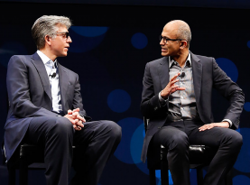
SAP and Microsoft – strong partners for your future The trusted, optimized, seamless enterprise-ready cloud partnership
Trusted
20+ year alliance partnering together for the benefit of our mutual customers
Microsoft runs SAP and S/4HANA
SAP runs internal S/4HANA on Azure
Seamless
Co-located engineering resources & aligned sales and marketing teams provide a seamless customer experience
Optimized
Unique capabilities, roadmap, and experience to support SAP HANA & enterprise workloads from on-premises and Azure
“We are taking our partnership to the next level… Together, we will help companies win the customer-driven growth revolution...”
—Bill McDermott, CEO of SAP
“Building on our longtime partnership, Microsoft and SAP are harnessing each other’s products to not only power our own organizations, but to empower our enterprise customers to run their most mission-critical applications and workloads with SAP S/4HANA on Azure.”
—Satya Nadella, CEO of Microsoft
Notes:
SAP and Microsoft’s partnership has a deep history -- and is now being taken to the next level – with a shared commitment to empowering the digital transformation of our customers.
The relationship between our two companies is:
TRUSTED
We have a 20+ year alliance partnering together for the benefit of our mutual customers with
85% of Fortune 500 using SAP & Microsoft Cloud
Microsoft runs on SAP S/4HANA. SAP runs on Azure.
We are both running our businesses on our new joint solutions, so customers can invest in the cloud with confidence
OPTIMIZED
Together we have unique capabilities, roadmaps, and experience to support SAP HANA & enterprise workloads from on premise to the Azure cloud
Azure has unique capability to support SAP-specific enterprise workloads due to our joint development agreement
SAP has a level of influence in the Azure roadmap to better support SAP customers
Extensive work has gone into running hybrid SAP landscapes (across on-premise, private and public cloud).
SEAMLESS
Co-located engineering resources -- and aligned sales and marketing teams -- provide a seamless customer experience
Sales, marketing, engineering and support organizations are aligned and incentivized to work together
Microsoft provides scale in geographies where SAP customers have the greatest coverage requirements

Slide 17
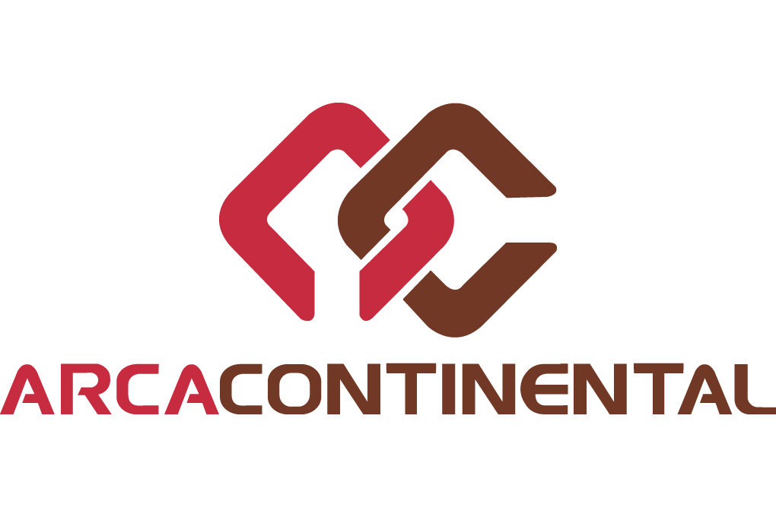

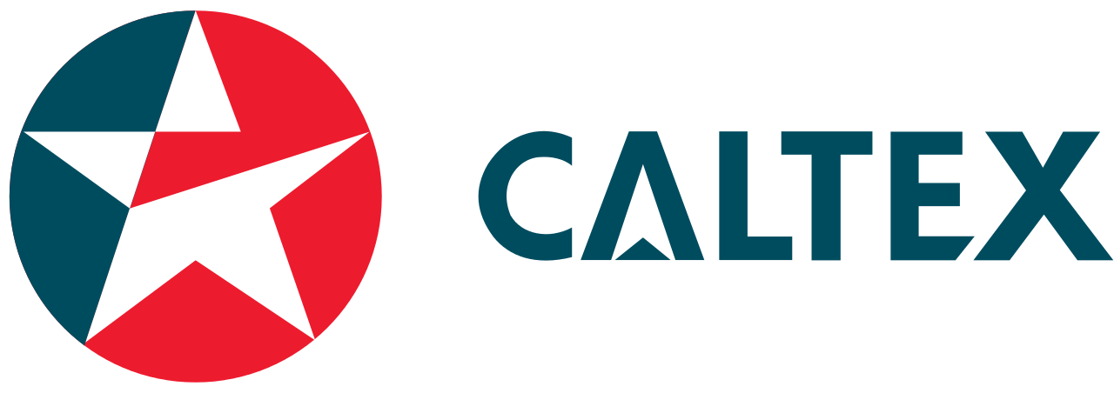
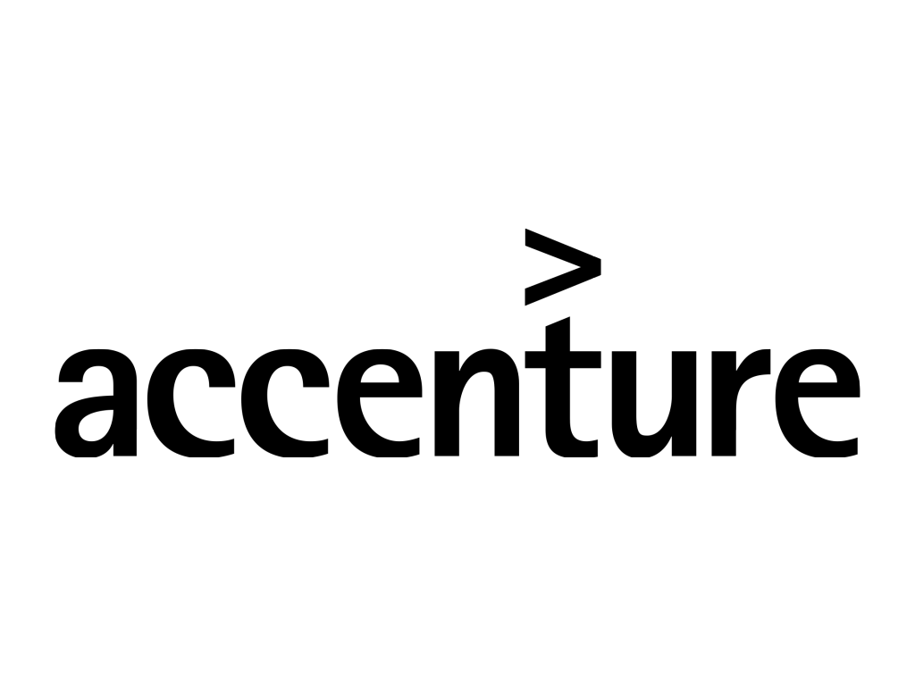



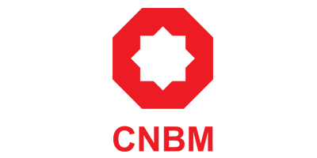






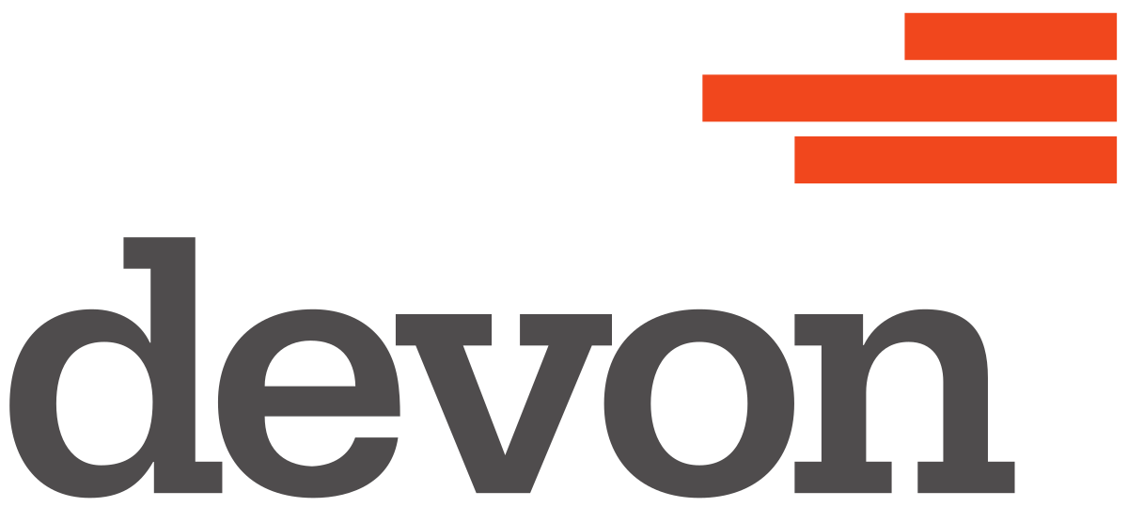
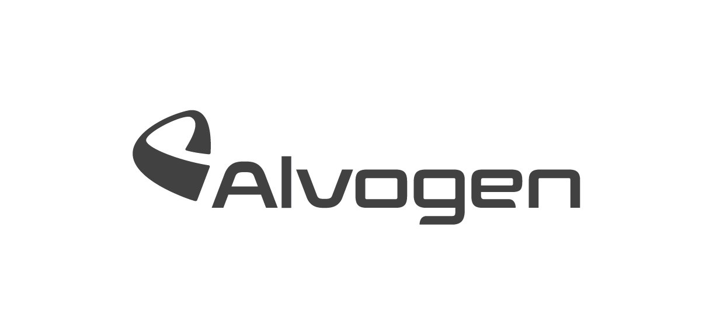




























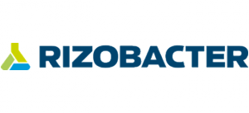

SAP on Azure customers
Retail, food, & CPG
Manufacturing, mining, and oil & gas
Utility, pharma, services, and multi-sector
SAP on Azure in Production in More than 40 Countries
Notes:
Enterprises run SAP on Azure in more than 40 countries running SAP production systems on Azure and we see a growing momentum of customer taking advantage of Azure’s capabilities across geographies and industries.

Slide 18
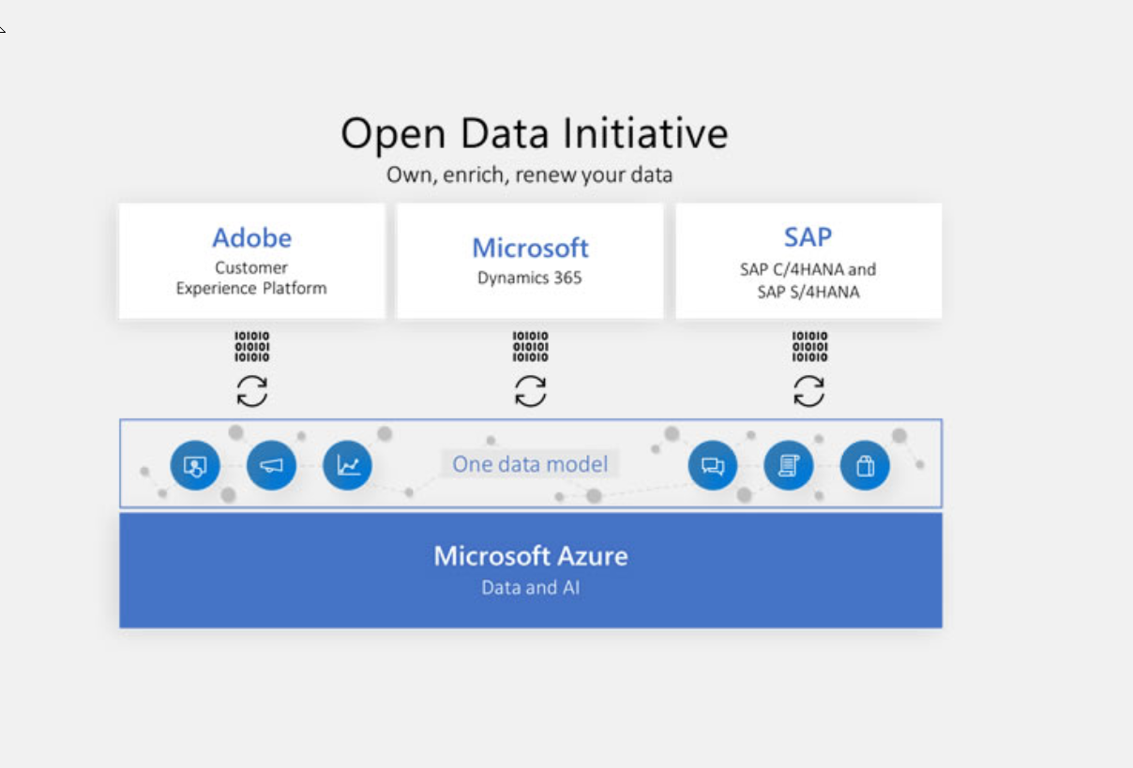
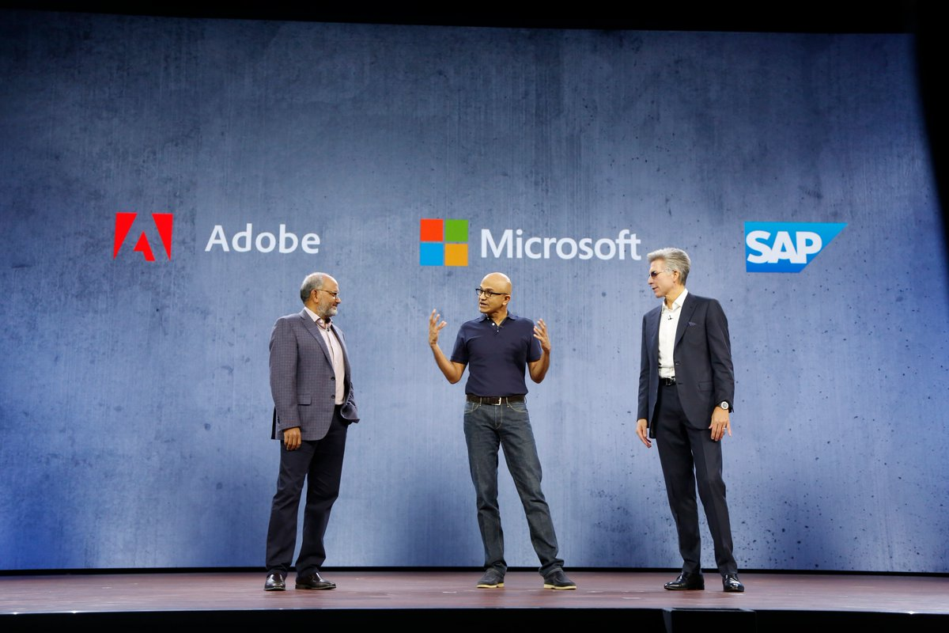
Open Data Initiative announced to empower a new generation of customer experiences
“Adobe, Microsoft and SAP are partnering to reimagine the customer experience management category. Together we will give enterprises the ability to harness and action massive volumes of customer data to deliver personalized, real-time customer experiences at scale.”
- Shantanu Narayen, CEO of Adobe
“Together with Adobe and SAP we are taking a first, critical step to helping companies achieve a level of customer and business understanding that has never before been possible. Organizations everywhere have a massive opportunity to build AI-powered digital feedback loops for predictive power, automated workflows and, ultimately, improved business outcomes.”
- Satya Nadella, CEO of Microsoft
“Microsoft, Adobe and SAP understand the customer experience is no longer a sales management conversation. CEOs are breaking down the silos of the status quo so they can get all people inside their companies focused on serving people outside their companies. With the Open Data Initiative, we will help businesses run with a true single view of the customer.”
- Bill McDermott, CEO of SAP
Notes:
Announced in October 2018 between SAP, Microsoft and Adobe
Enable a new level of business insight
Remove silos and reclaim your data
Unlock business insights
Rely on our promise of trust and openness

Slide 19




SAP on Azure maturity
Hyperscale Cloud
Enterprise DNA
Purpose-Built for SAP
42
42
Global Regions
Global Regions
33k Miles
33k Miles
Active Fiber
Active Fiber
1989
SAP Relation-
ship
17
Enterprise Apps SAP runs on Azure
20/60
TB
SAP Certified
2 Prong
Pioneers of Virtual & Bare Metal
$1 B
Spent on Security Annually
50TB
Microsoft SAP estate in Azure
220+ SIs
WW focused on SAP on Azure
30-70%
Cost Savings
HA+DR+Backup Integrated
8k+
ISP Sessions
71 Compliance
Certifications
SCP and HEC on Azure
99.99% SLA
OLAP &OLTP
42
Global Regions
Active Fiber
Secs
Full 60TB backup
33k Miles
Active Fiber
>100k Cores
Elasticity
>4K
Ready Market Place Offerings
82%
License mobility and HUB Savings
33k Miles
Joint Support with SAP
Active Fiber
192GB-24TB
Widest range
26 Sizes/22 Regions
For every purpose
Notes:
Microsoft and SAP have worked together to ensure that Azure is the best public cloud platform for SAP. Here are just some of the ways the two solution sets combine to provide the most robust, reliable, scalable, and future-proofed solution for ERP globally.

Slide 20

Microsoft runs SAP on Azure
Completed 50TB data migration to Azure in Feb 2018
Deliver reliant and agile ERP platform
Enable modern experiences
Provide real-time processes
16TB Highly compressed database | 300K Monitored batch jobs/month | 4M Dialog steps/day | 110K Internal users (Mostly Indirect Access to SAP)
6K Named user accounts | 99.998% Raw SQL/Win uptime |  | 0.4 Seconds user response time
 | 170M Transaction steps/month | 5-7 % yearly Incident ticket reduction | 2X System growth in past 2 years
≈600 Servers | 250TB Compression storage savings | 2X Transaction volume over 18–24 months | 96% Non-SAPGUI users
Notes:
And we’re users ourselves of SAP on Azure. With more than 100,000 internal users running SAP on Azure, Microsoft has first-hand knowledge in now to use these two platforms together successfully.
Our own experience has demonstrated the platform’s success in terms of uptime, scalability, and cost savings.

Slide 21
Thank you

Slide 22
Appendix A: Case studies

Slide 23
A note on case studies
The following case studies are included as examples of how the SAP on Azure story can be told. We encourage partners to include their own case studies in this presentation if available.

Slide 24
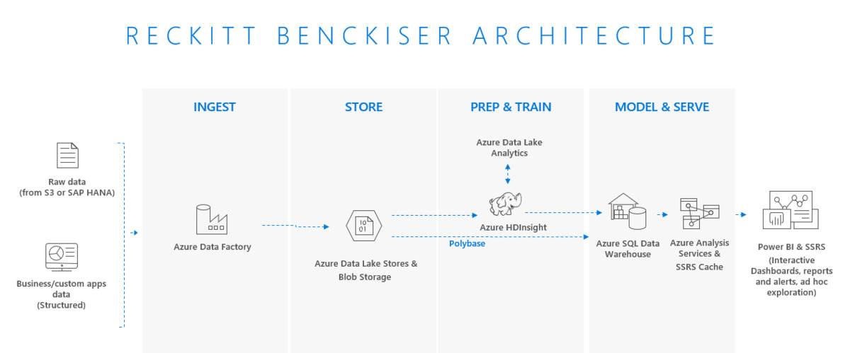
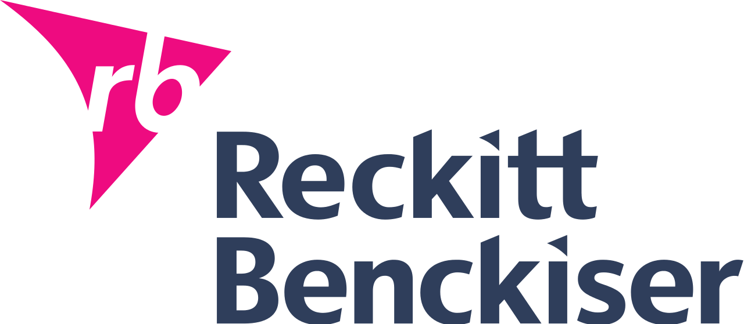

Business insights with SAP and non-SAP data on Azure
“We delivered a simple Power BI solution to our salespeople that they view on their smartphones. Because we can now integrate point-of-sale data, sell-out data, and other third-party data, we can determine which SKUs are not selling in each store each week.”
—Wilmer Peres Information Services Director Big Data and Analytics Reckitt Benckiser
Notes:
https://customers.microsoft.com/en-us/story/reckitt-benckiser-consumer-goods-power-bi
RB is a United Kingdom–based global consumer goods company that produces health, hygiene, and home products. Our brands include the antiseptic brand Dettol, the sore throat medicine Strepsils, and Mead Johnson, Nurofen, Air Wick, Cillit Bang, Clearasil, and Lysol, among others. We have 40,000 employees around the world whose shared vision is simply to help people feel better.
Problem:
Data. To make good decisions, salespeople, marketers, product developers, and executives all need data to understand what’s going on with the business and, more importantly, to know what to do next.
About four years ago, our global business intelligence (BI) team realized that to gain those kinds of crystal-ball insights, we needed more than just our internal operational data. We needed third-party data so we could determine what’s going on with our products at various retailers, how we compare to other consumer goods companies, where we should grow, and many other insights. We also needed to do a better job of helping employees make sense of proliferating data.
We tried creating a hybrid data architecture using Amazon Web Services (AWS) for back-end data services, but AWS reporting tools didn’t fit our needs. We had to architect in a third-party BI tool. But this tool kept breaking, and staff spent a lot of time remediating performance issues. Plus, the mobile version of the tool was incredibly difficult to use.
We contacted Microsoft about using Microsoft Power BI. We had invested a lot of time in the AWS platform and felt that we only needed to replace the front end. But our local Microsoft account team helped us see that we could use Microsoft Azure to build a modern data warehouse solution to replace our AWS data warehouse and Hadoop components and save money in the process. Plus, putting our data services in Azure would allow us to take advantage of advanced security and intelligence capabilities of the Microsoft Cloud.
Azure gave us the integration of back-end data with front-end data consumption tools, such as Power BI and Microsoft Office. There are fewer moving parts, it’s easier to maintain, and we save licensing costs. We were able to pay for the new platform with the first-year savings.
Data comes in from third-party data warehouses and our SAP business systems. We use Azure Data Factory to orchestrate data collection, then we bring it into Azure Blob storage, which puts it into Azure Data Lake Store. We use Azure HDInsight to crunch the data, then we push it into Azure SQL Data Warehouse as the data hub for reporting. Azure Analysis Services is the presentation layer that serves data to Power BI clients.
I might mention that we created this entire solution in just six months, which was crazy for a project of this scope. Using fully managed cloud services let us move faster.

Slide 25


Accelerating IT transformation with SAP on Azure
Organization size
6000+ employees
Revenues
14.6B USD
SAP landscape
1.4 TB ECC Database and 1.2TB of SAP BW
6800 named users and 1200 daily active users
OpenText Archive Server, IBM Sterling B2B Integrator
Business need
Datacenter exits, increased performance, M&A integrations
Modern data warehousing and reporting
Microsoft services
SAP on Azure, ExpressRoute, Application Gateway, Site Recovery, PowerBI
Business results
Vacated 18 datacenters and reduced operating costs by 30%
Scale up to meet peak demand and scale down upon completion
“Moving SAP infrastructure from a traditional outsourced hosting model to an Azure model managed by internal IT resources reduced our costs by 30 percent. The 16-month payback and 117 percent internal rate of return prove that migrating SAP to Azure was the right decision.”
— Lorin Phillips
Director of Hosting and Network Delivery
Notes:
https://customers.microsoft.com/en-us/story/dfa-consumer-goods-azure

Slide 26

Accelerating time to value with SAP on Azure
Organization size: 55,000 employees
Revenues: 33.7B USD
SAP landscape
24 SAP applications
2 environments with 8TB and 7.5TB database
35 TB of data
IBM DB2 to SQL Server
Business need
Respond to market conditions—pricing volatility in commodities
Business agility for proof of concept and innovation
Microsoft services
Azure VMs, Premium Storage, Azure Backup, Office 365
Business results
Vacated four datacenters and reduced operating costs by 30%
Foundation for supply chain productivity with IOT
Secure mobile access to field workers for company data and collaboration
Notes:
Rio Tinto is a leading global mining and metals company, headquartered in Australia but they operate throughout the world.
A few years ago, Rio Tinto decided to undertake a massive transformational project that to modernize core enterprise IT systems to an “As-a-Service” solution based in the cloud
As a part of this they were looking for a cloud that could power all of their business processes which are based on SAP
SAP for Rio Tinto is mission critical with 40,000 users and 365 days a year operation. If their SAP application stops, their mining operations and trucks have to stop.
This is one of the largest deployment of SAP in the public cloud with a 8TB database size.
They chose Azure, and moved over 1000 servers, as well as migrated to SQL Server from DB2 in the process.
The customer saw significant benefits in business agility, such as scaling up for year-end peak demand and in addition some significant cost savings in the 20-25% range.

Slide 27
Appendix B: Technical detail slides

Slide 28
Robust cost-effective infrastructure for SAP NetWeaver
SAP Business Suite on any DB (Oracle, IBM DB2, SAP ASE, SQL Server), and all SAP NetWeaver based applications are certified for production.
</>
Dev, test & training
Disaster recovery as a service
Backup and archiving
Cost effective
Production
40–75% TCO cost savings for dev/test
Minutes Provisioning in minutes, not weeks/months
60% less storage costs for archiving data
40% less for Windows Server VM vs. other cloud options
54 Regions available with 99.95% SLA

Slide 29

SAP HANA Infrastructure on Azure
On-demand infrastructure
Purpose-built infrastructure
E-series VMs for dev/test & PoC
M-series VMs for most implementations
SAP HANA Large Instances for extreme scale & performance
Up to 0.5 TB RAM
Globally available
192 GB to 4.0 TB RAM
SAP HANA Certified for production
0.7 TB to 24 TB RAM
SAP HANA certified for production
Notes:
When it comes to running SAP HANA, Azure offers the most scalable platform of any cloud provider. Azure is the only cloud provider that offer single node scale up configurations up to 24 TB while offering a cost effective and high performance on-demand VM infrastructure certified for SAP HANA. Let’s dive into these in a bit more detail.

Slide 30
On-demand infrastructure for SAP HANA
4TB
M128ms
OLTP
Hyper-threaded VMs
Intel® Xeon® E7-8890 v3 processor
DDR4 memory
<1ms latency for storage writes
Flexible CPU to memory options
Available in 10 regions today and 12 more launching by end of 2018
On demand pricing
82% savings with 3-year reserved VM instances
Deployment in minutes with automation templates
OLTP & OLAP (single-node)
3TB
M128s
Memory (in GiB)
M64ms
2TB
M64s
M32ms
1TB
M64ls
512
M16ms
M8ms
M32ls
256
M32ts
219
8
16
32
64
128
vCPUs

Slide 31
Purpose-built infrastructure for SAP HANA
24
S768xm
OLAP
S960m
SAP HANA TDI configuration
Intel® Xeon® processor E7-8890 v4
Persistent NFS storage
Scale-up to 24TB and scale-out to 60TB
Built-in online backup in seconds with snapshots
Available in 8 regions in US, EU, AU, and JP
TDIv5 SKUs allow lower price/TB scaling
99.99% SLA for HA Pair
22
OLTP
20
S576xm
OLTP TDIv5
18
S768m
16
14
S384xxm
S576m
12
Memory (in TB)
10
S384xm
8
S192xm
S384m
6
S192m
S384
4
S72m
S192
2
S72
S96
0
72
192
384
576
768
960
CPU threads

Slide 32



SAP HANA on Azure VM architecture
On-premises SAP user
HANA on M-series VMs can be made highly available with OS clustering such as Fencing and Stonith on SUSE or RedHat
App Server VMs are made highly available with Azure VM availability set
M-series VMs offer Write Accelerator for high performance
HANA System Replication (asynchronous) enables DR configurations
Primary Azure Region
OS clustering
HA via HSR
Front-end Express route
SAP ASCS on VM
SAP App Server on VM
SAP HANA VM Primary (active)
SAP HANA VM Secondary (standby)
Azure Premium Storage for primary VM
Azure Premium Storage for secondary VM
HSR Asynchronous
DR Azure Region
SAP App Server with ASCS
Azure Premium Storage for QA
SAP HANA VM (DR/QA)
Azure Premium Storage for DR

Slide 33

SAP HANA on Azure HANA large instance architecture
On-premises SAP user
HANA on HLIs can be made highly available with OS clustering such as Fencing and Stonith on SUSE and data replication via HSR
App Server VMs are made highly available with Azure VM availability set
HANA Large instances offer high performance NFS storage with <1ms write latency
HLIs are connected with a 40GB network
Storage snapshot replication offers built-in disaster recovery
Primary Azure Region
OS clustering
HA via HSR
Front-end Express route
SAP ASCS on VM
SAP App Server on VM
Back-end Express route
SAP HANA Large Instances Primary (active)
SAP HANA Large Instances Secondary (standby)
Snapshot
NFS storage Primary
NFS storage Secondary
HA Pair
DR Azure Region
DR storage replication
QA (NFS) Storage
SAP HANA Large Instances (DR/QA)
DR (NFS) Storage

Slide 34
Only enterprise-grade SAP HANA environment in public cloud
Primary
Secondary
M
S1
S2
SB1
SB2
HSR
STONITH
OLTP – Scale up to 24 TB Up to 20 TB certified with 99.99% SLA
HA with automatic failover
OLAP - Up to 60 TB certified with 99.99% SLAs
N+M scale out for cost effectiveness
Automatic host failover
Single node SLAs
Integrated backup and disaster recovery
Live, consistent, full snapshots in seconds
Scheduled - Every 8 hours, daily, weekly
Point in time recovery
Mirrored snapshots at a paired datacenter located >500 Kms away
Notes:
When it comes to SAP HANA options in the public cloud, our HANA Large Instances is the only enterprise grade option because of the need for a shared NFS storage that allows for automatic host failover in addition to offering single node SLAs of 99.9% and 99.99% SLA in a HA pair configuration. With the built in backup and DR capabilities customers have the most RTO and RPO to meet business continuity needs.

Slide 35
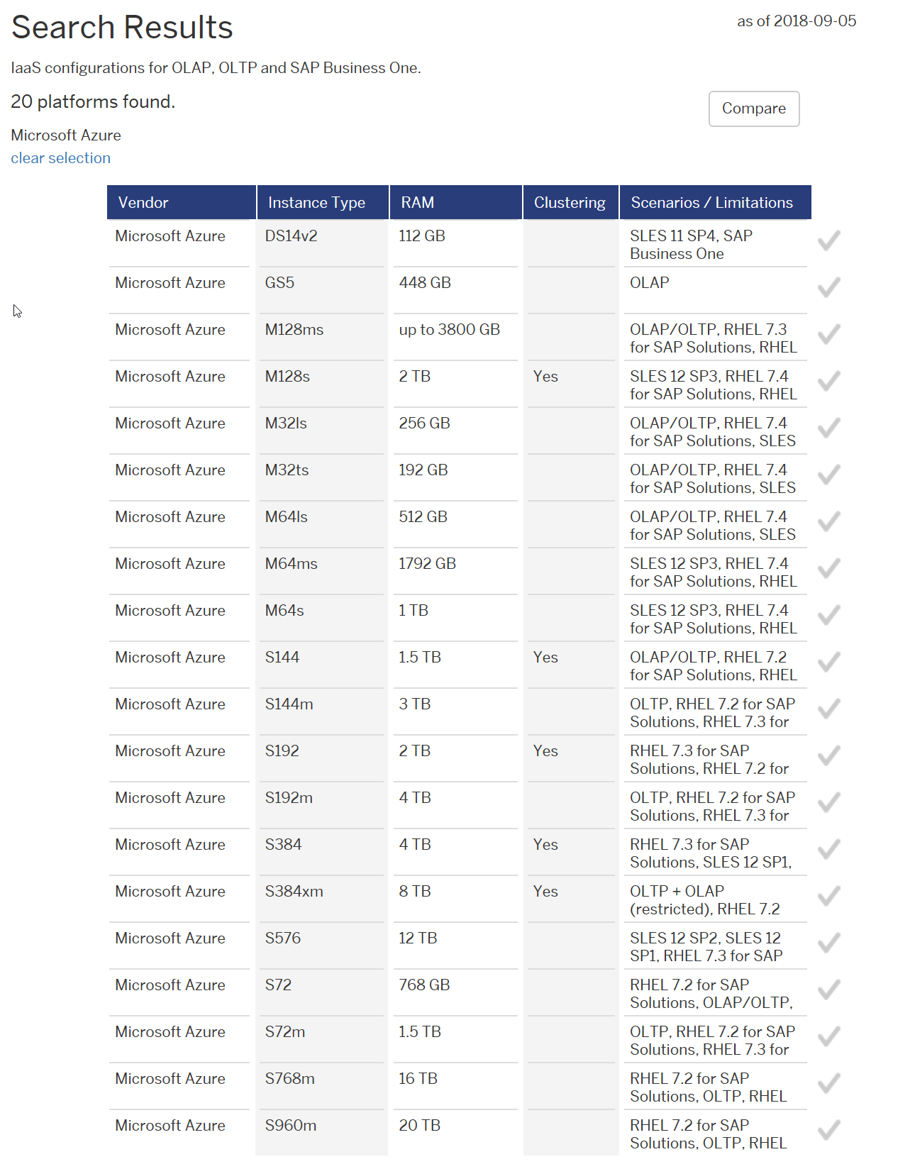
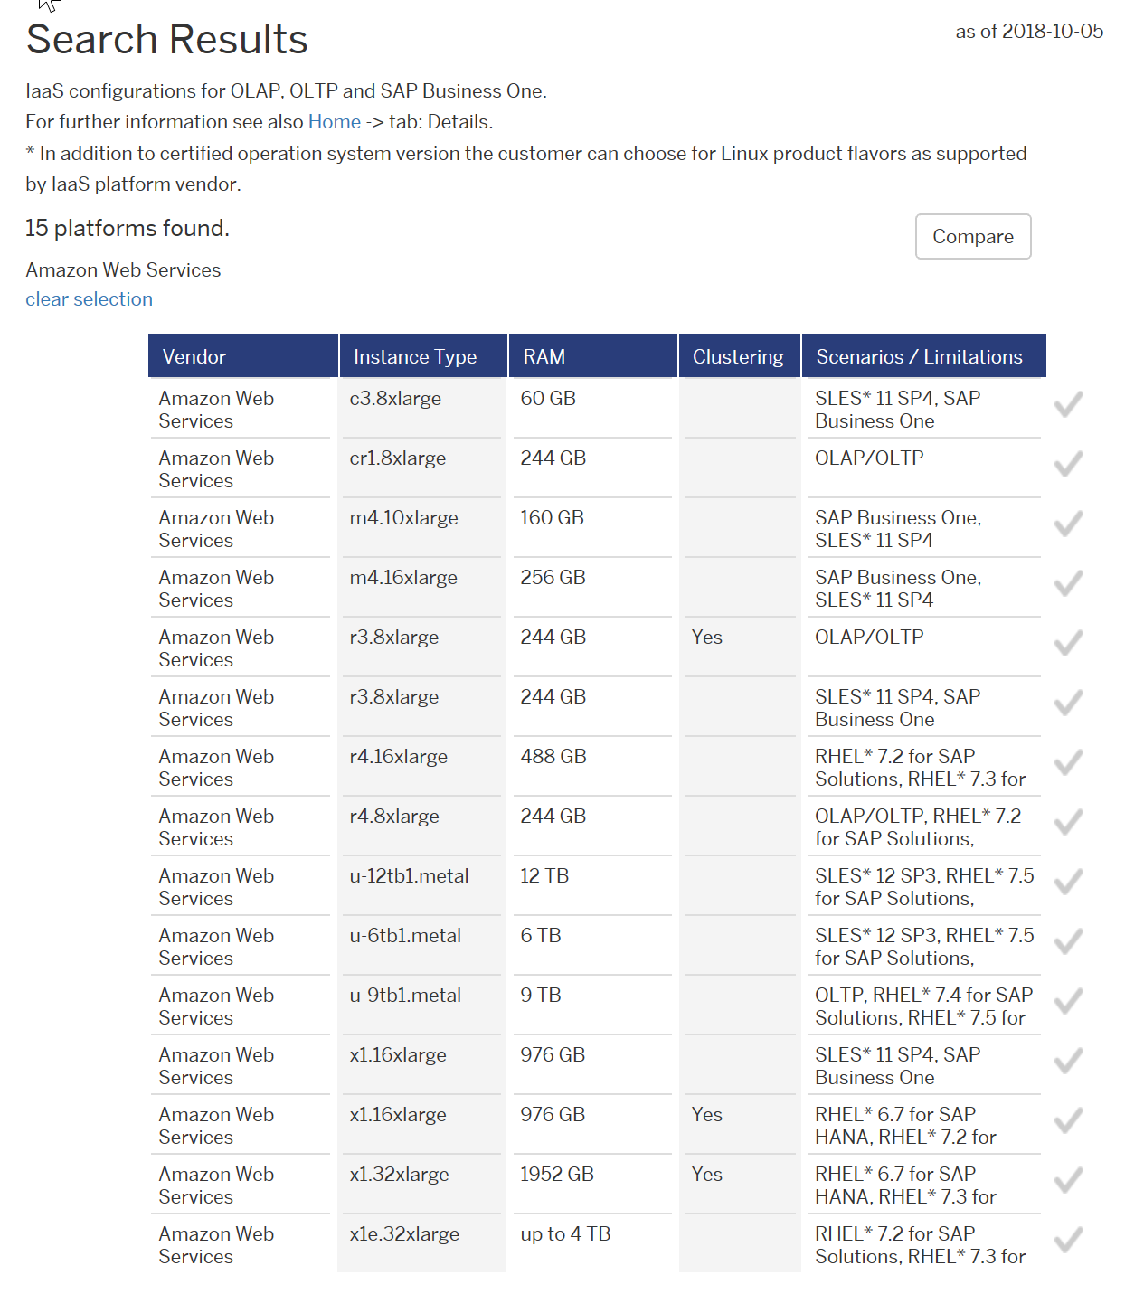
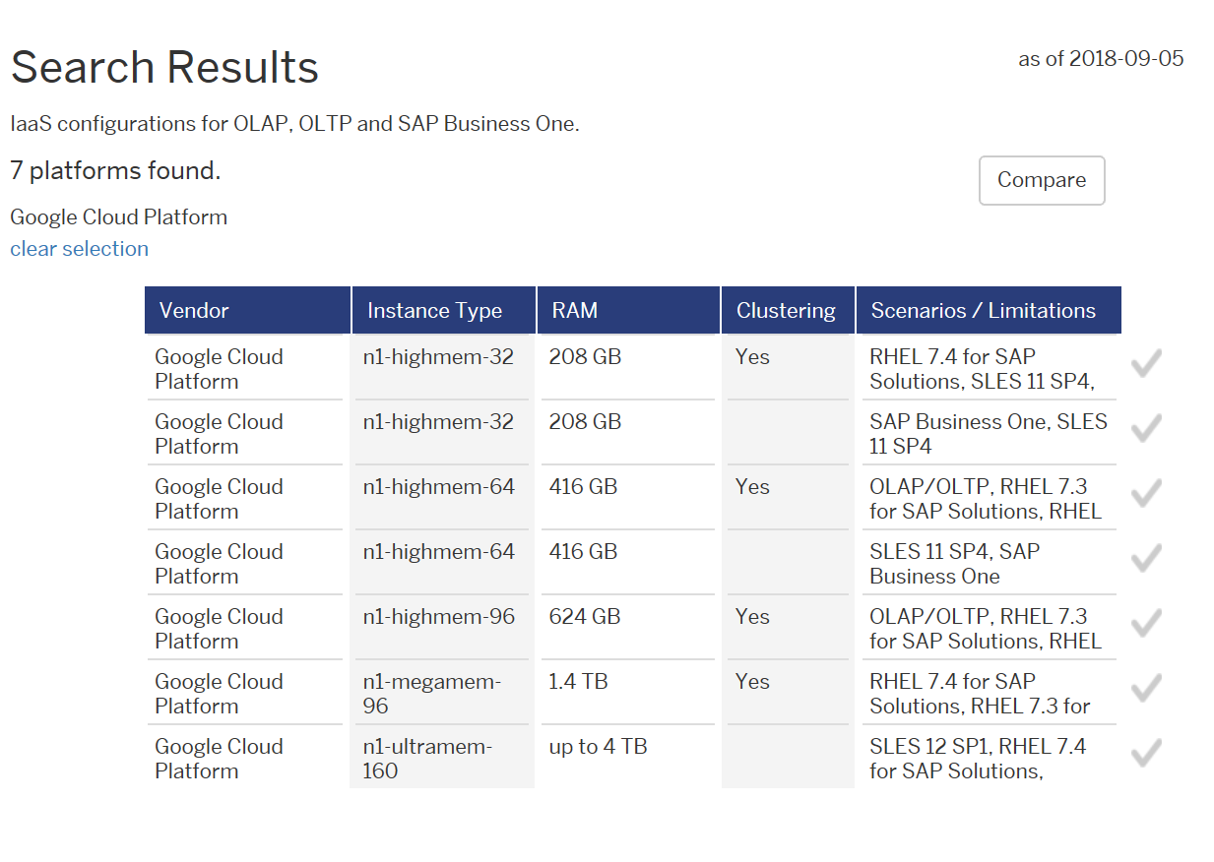
Most number of HANA certifications in the public cloud
Azure: 20 certifications from 112 GB to 20 TB
AWS: 15 certifications from 60 GB to 12 TB
GCP: 7 certifications from 208 GB to 4 TB

Slide 36
Disk storage for SAP HANA
Certified for SAP HANA
NEW! Public Preview
Standard HDD
Standard SSD
Premium SSD
Ultra SSD
Size
32 GiB - 32TiB
128 GiB -32TiB
32 GiB - 32TiB
4 GiB - 64TiB
IOPS
500 - 2,000
500 - 2,000
120 - 20,000
100 – 80,000
Bandwidth
60 - 500 MBps
60 - 500 MBps
25 MBps - 750 MBps
1 MBps - 2,000 MBps
Notes:
Azure Disks are designed for 99.999% availability and have consistently delivered enterprise-grade durability with an industry-leading zero-percent annualized failure rate. Take advantage of our single instance virtual machine SLA of 99.9% with Premium Disks.
Standard HDD: Low-cost storage for infrequent data access
Use Azure Standard HDD Managed Disks for noncritical workloads that require infrequent access to your data, when you don’t need production-level performance. Attach Standard HDD disks to any Azure VM to achieve cloud scale for your development and test scenarios, at affordable price points.
Standard HDD can also be used for backup and archiving applications.
Standard SSD: Cost-effective and consistent performance
For a cost-effective disk offering that can work with any Azure VM and that’s designed to provide consistent latency for low-IOPS workloads, deploy Standard SSDs.
Improve reliability and scalability for your applications.
Deliver lower latency compared to Standard HDDs.
Experience the same industry-leading durability and availability you expect from Azure Disk Storage.
Standard SSDs can support diverse workloads, such as web servers, low-IOPS application servers, lightly-used enterprise applications, and dev/test scenarios. Upgrade to Premium SSDs for more demanding and latency-sensitive workloads.
Premium SSD: High-performance disk storage for production workloads
When performance is critical, take advantage of the low latency and high throughput of Azure Premium SSD.
Build your high-performance database with a broad range of Azure Virtual Machines for the speed that’s needed for enterprise workloads.
Reach maximum disk performance of up to 20,000 IOPS and 750 MB per second provisioned.
Experience maximum disk throughput per virtual machine of up to 80,000 IOPS and 2,000 MB per second—and even faster with caching.
Deploy Premium SSD in conjunction with DS-series virtual machines: a unique caching architecture can deliver lower latency and increased performance.
Premium SSDs represent a good fit for production workloads, such as SQL Server, Oracle databases, Microsoft Dynamics, Microsoft Exchange Server, MySQL, Cassandra, MongoDB, and SAP Business Suite.

Slide 37

SAP cloud platform on Azure
Develop SAP applications on SAP Cloud Platform running on Azure
Co-locate your applications and ERP data for low latency
Unified cloud for your SAP infrastructure and development
Several enterprise customers run Pivotal Cloud Foundry on Azure: Ford, Manulife, Merrill Corporation
Leverage Azure PaaS services for containers and Kubernetes
Get started now!

